Slide 1
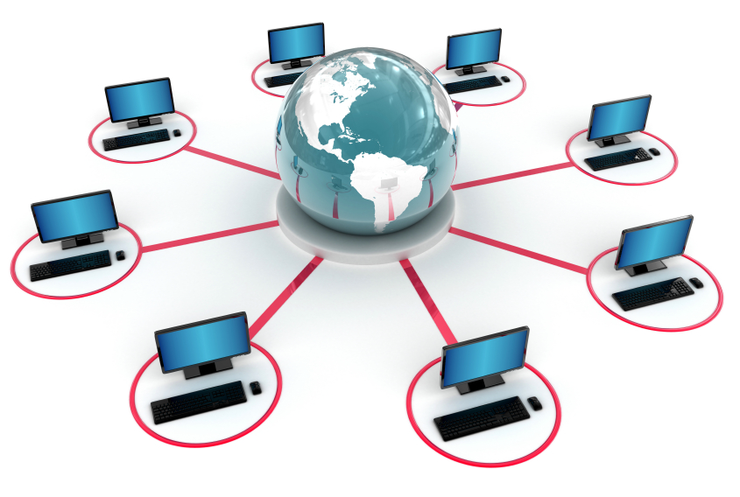
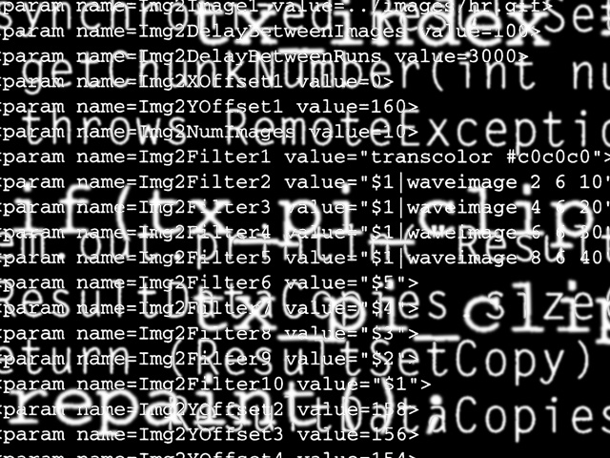
School of Information
Technology
Code Collaboration
http://www.istockphoto.com/stock-photo-5662949-global-network-xxxl-13333x8975-px-.php
http://www.mlab.uiah.fi/~malappal/infoaesthetics/jpegs/code.jpg

Slide 2
Objectives
To provide an overview of ways to collaborate on code (or any plaintext files)
To provide an introduction / overview of:
  Patches
  Version Control Systems (VCS)
  Centralized vs Distributed version control
To provide a brief coverage of different ways to work together

Slide 3
The Problem
With multiple people working on a project, there is a need for people to collaborate on files
    For example: configuration files, source code, documentation, etc.
Code is fragile:
    In each area of collaboration, features need to be complete (and somewhat tested) before they are added to the files used by other team members

Slide 4
Simplistic Solution
(for very small projects)
Break tasks into small subsections that can be developed completely separately
  For example, separate programs that will work together
Each team member works in isolation
Then, the systems are merged or combined and tested together
This work flow is not always realistic or possible

Slide 5
Patches!
One solution is to create patches that describe just the things that have changed
A patch file can store a “delta” version
  Only the things that have changed are stored
  For example, a long file with a small change, only the change is stored in a patch file

Slide 6
Diff
Diff is a popular program used to create patches
Originally developed for Unix, available on most systems
diff -u old-file-or-dir new-file-or-dir
The above command shows the lines that have changed, and the lines that surround the changes

Slide 7
Diff – Example
Create a text file and name it example.txt
Type something in the text file
Copy example.txt to example2.txt
Change one line somewhere in example2.txt
Enter the command:
diff -u example.txt example2.txt > myexample.patch

Slide 8
Patch
patch applies patches created using diff
patch old-file-or-dir patch-file
Makes the changes to the file
Option: -pnum can change the way files are located

Slide 9
Patch – Example
To share your changes with someone else
You would send “myexample.patch”
They then enter the command:
patch example.txt myexample.patch

Slide 10
Diff - Patch
This approach to sharing code is good for small projects, especially where coders come and go and contribute small amounts of code
The Linux kernel (one of the largest scale software projects in the world) used to use a method similar to this, but this soon became impractical

Slide 11
Problem
Can't see who contributed what code
Can't see a history, or easily revert to older versions
There is a need to work more effectively on shared code

Slide 12
Version Control
Version control (sometimes called revision control) provides a solution
  Works with any files (best suited to plain-text files)
  Allows people to more effectively work together on larger projects, with a history that everyone can see

Slide 13
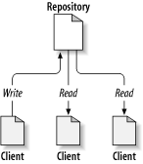
Version Control
Like a shared filesystem
With a detailed history
People can write to and read from the repository
Write is in terms of sets of changes

Slide 14
Version Control
There are three main types of version control systems:
  Local
  Centralized
  Distributed

Slide 15
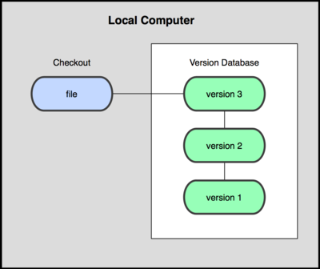
Local Version Control Systems
All history is local
Allows you to revert to older versions
Easier than manually creating copies with timestamps
Example system: rcs
Image: http://progit.org/book/ch1-1.html

Slide 16
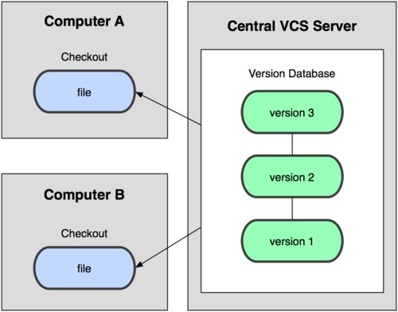
Centralized Version Control Systems (CVCS)
There is one copy of the repository that everyone writes to and reads from
Examples: CVS,
Subversion,
and Perforce
Single point of
failure
Need server to
do version-ed
work
Image: http://progit.org/book/ch1-1.html

Slide 17
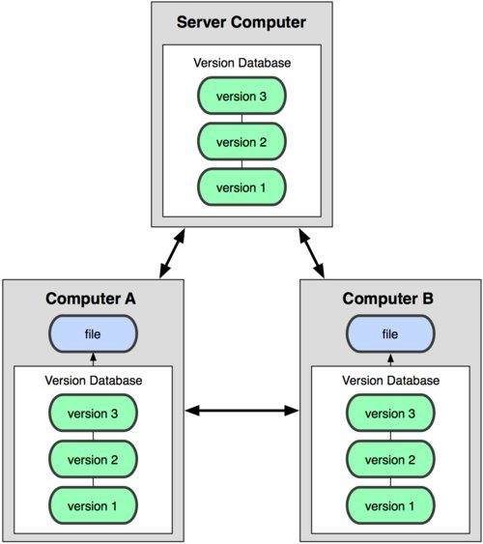
Distributed Version Control Systems (DVCS)
Everyone has their own local copy of the entire history of the project
People share by pushing their changes to their own server repository, or to a shared server repository
Examples: Git,
Mercurial, Bazaar,
and Darcs
Image: http://progit.org/book/ch1-1.html

Slide 18
Main Features of Most VCS
Commit: save changes to the history of the project
Checkout: work on a different version
Branch: work on a different feature
Tag: remember where releases were
Merge: combine versions

Slide 19
Note
The following examples use Git
Git is a DVCS created by Linus Torvalds (creator of the Linux kernel)
  He named both systems after himself
Linus has famously derided Subversion (the other main popular VCS amongst open source developers), although the system you may choose will depend on how you want to collaborate

Slide 20
Setup
git config --global user.name “Peter Cole"
git config --global user.email “p.cole@murdoch.edu.au"
Unix/Linux users could use a simple text editor:
git config --global core.editor “gedit"
Windows users could use a simple text editor:
git config --global core.editor "notepad"

Slide 21
Work on an Existing Project
git clone repository-url
Simple as that
You now have the full history of the entire project on your disk

Slide 22
Start a New Project – Example
git init
Simple as that
Adding files to track:
git add *.txt

Slide 23
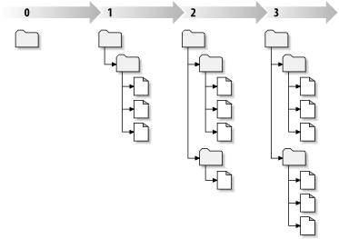
Commit
Once you have made a set of changes that you want to save to the version history you “commit” (to) them
git commit -a -m “description”
Image: http://svnbook.red-bean.com/en/1.5/svn.basic.in-action.html

Slide 24
See Changes and Revert
See list of commits:
git log
See what has changed, still to commit:
git diff
Graphical view:
gitk --all
Go to the previous version
git checkout HEAD~1
Back to the current version
git checkout master
Image: http://svnbook.red-bean.com/en/1.5/svn.basic.in-action.html

Slide 25
Tag
Tag a version with a name:
git tag “1.0”
Remembers that at this point in time version 1.0 was released
Many of the commands can use tag names to identify points in the history

Slide 26
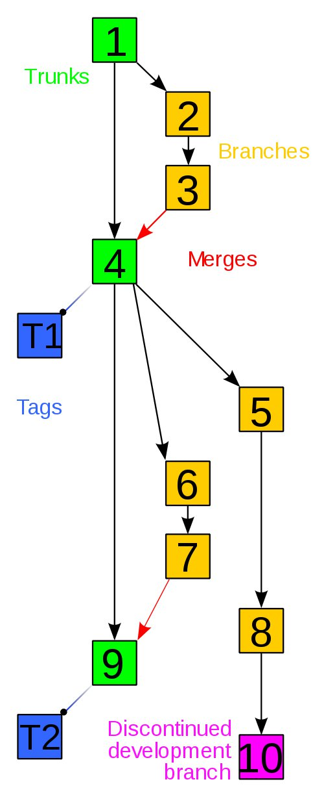
Branch
You can keep changes (such as new features) in branches until they are ready to be merged into the main “trunk”
Image: http://en.wikipedia.org/wiki/File:Revision_controlled_project_visualization-2010-24-02.svg

Slide 27
Branch
To create a new branch:
git checkout -b name
Back to main branch:
git checkout master
Image: http://en.wikipedia.org/wiki/File:Revision_controlled_project_visualization-2010-24-02.svg

Slide 28
Merge
To merge one branch into another:
git merge otherbranchname
If there are conflicts, the merge will do what it can and flag the conflict in the file
Once you are happy use commit
Image: http://en.wikipedia.org/wiki/File:Revision_controlled_project_visualization-2010-24-02.svg

Slide 29
Working Together:
Remote Repositories
Getting a remote repository
  You can set up your own server; or,
  There are lots of free hosting services for open source projects: such as sourceforge and github
Sharing – Push to remote repository:
git push (once set up)
Get latest from the remote:
git pull

Slide 30
Working Together: Merging
Depending on the VCS, if you try to push to a repository, and you are not up-to-date:
  you need to pull first
    (git automatically merges your commits),
  deal with any conflicts and commit,
  then push again

Slide 31
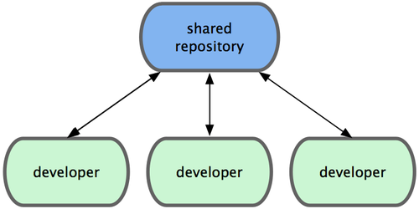
Centralized Workflow
There are lots of ways of working together
You can all push to the one repository:
You can do this with a CVCS or a DVCS
Image: http://progit.org/book/ch5-1.html

Slide 32
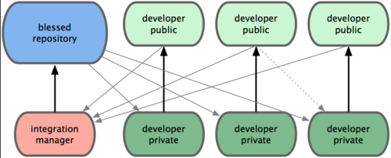
Integration-Manager Workflow
One person is in charge of vetting changes:
  This is how many small-to-medium sized projects are run
  Each developer pushes to their own repository
  The integration manager pulls their work and commits to the main repository
Image: http://progit.org/book/ch5-1.html

Slide 33
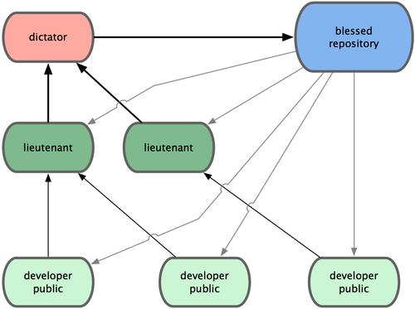
Dictator and Lieutenants Workflow
A benevolent dictator has final say and has lieutenants that vet code from others
The dictator maintains the “official” repository
The Linux kernel
is developed like
this! Each kernel
subsystem has a
“maintainer”
Image: http://progit.org/book/ch5-1.html

Slide 34
Code Review
Code review is important for quality assurance
There are lots of ways code can be reviewed
It is helpful to look at a large project to illustrate

Slide 35
Code Review
The Linux kernel has a code review process where:
  Changes are signed-off by the developers that produced the code
  Each change is emailed to mailing lists as a patch set (generated by Git)
  Developers give constructive comments and can add reviewed-by tags
  If a maintainer is happy with or against the changes they can ACK or NACK it

Slide 36
Quote from Linus
These days, most of the patches in the kernel don't actually get sent directly to me. That just wouldn't scale, but the fact is, there's a lot of subsystems I have no clue about, and thus no way of judging how good the patch is. So I end up seeing mostly the maintainers of the subsystem, and when a bug happens, what I want to see is the maintainer name, not a random developer who I don't even know if he is active any more. So at least for me, the _chain_ is actually mostly more important than the actual originator.
– Linus Torvalds

Slide 37
Summary
Version control is vital in many IT projects
We have covered:
  Patches
  Centralized vs Distributed VCS
    Main features: commit, merge, branch, and tag
  Git examples
There are lots of details that we have not covered, but this has aimed to give you an understanding of VCS

Slide 38
Recommended Reading
Pro Git: book, free online by Scott Chacon
http://progit.org/book/
Version Control with Subversion: book, free online by Ben Collins-Sussman, Brian W. Fitzpatrick, C. Michael Pilato
http://svnbook.red-bean.com/en/1.5/index.html
A Visual Guide to Version Control: web page by Kalid Azad
http://betterexplained.com/articles/a-visual-guide-to-version-control/

